Slide 1
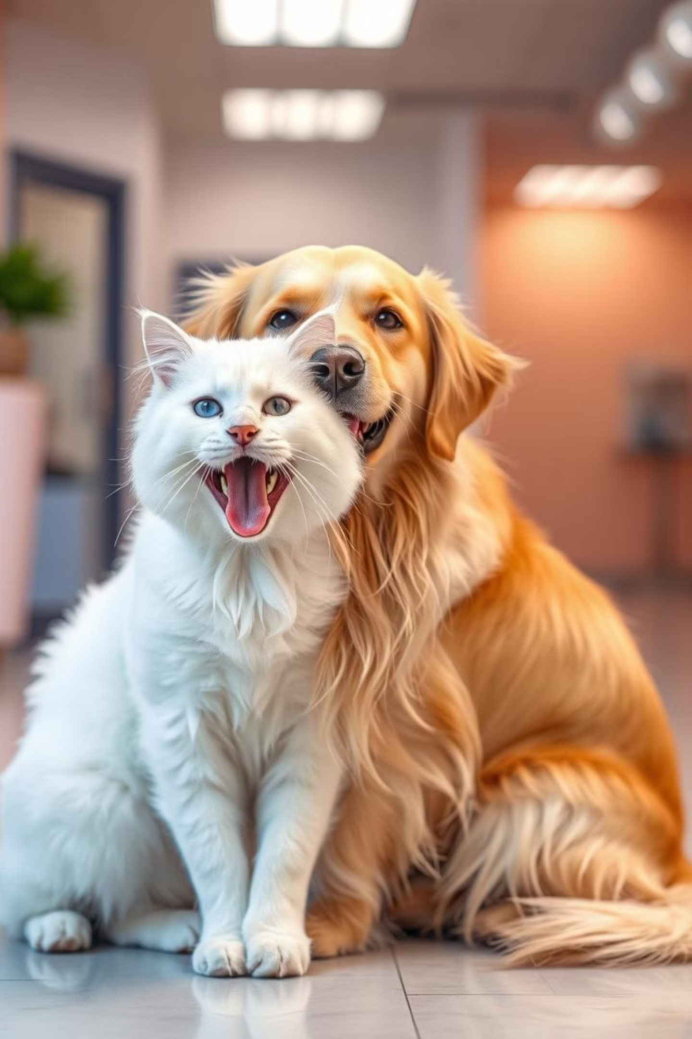
Rahi Pet Care: A Responsive Web Solution
Discover Rahi Pet Care, a multi-page responsive website designed to provide essential pet care services and information.

Slide 2



Project Overview & Structure
Modern Web Practices
Responsive Design
Essential Services
Built with HTML, CSS, Bootstrap, and basic JavaScript.
Ensures optimal viewing across various devices.
Provides key information and services for pet care.

Slide 3
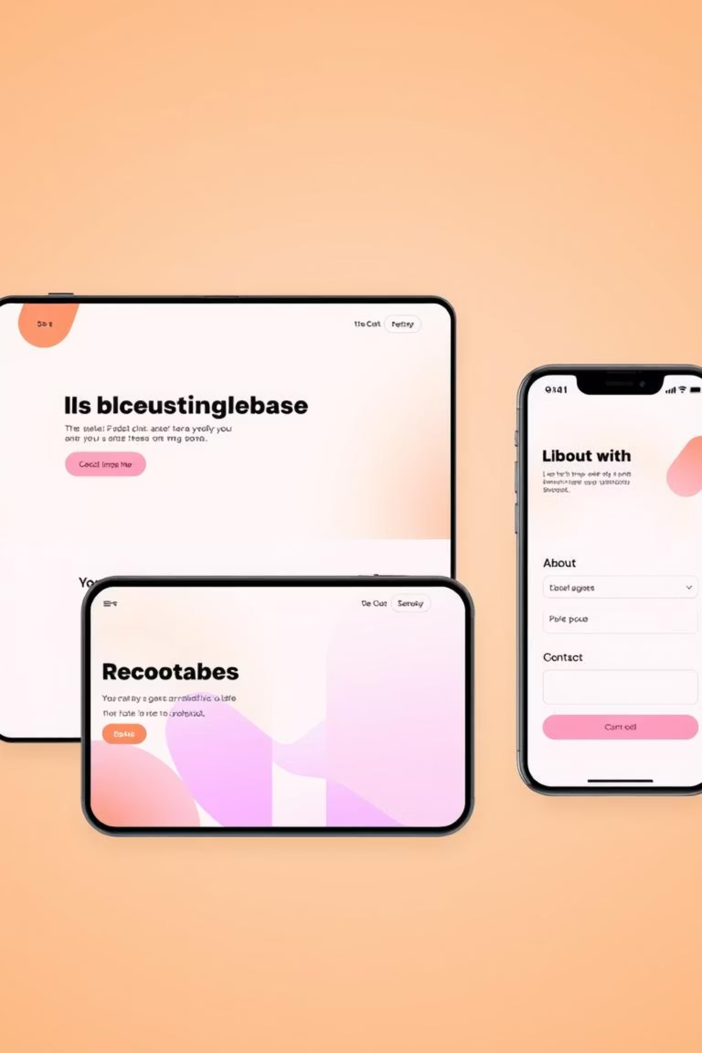
Key Project Components: Pages
index.html
about.html
contact.html
Homepage with navigation, banners, and links.
Details about the organization, mission, and services.
Form-enabled page for user contact and feedback.

Slide 4




Technologies Utilized
HTML5 & CSS3
Bootstrap 5.3
Foundation for content and styling.
For responsive design and UI components.
Custom Stylesheet
CDN Integration
External style.css for consistent branding.
Bootstrap and icons via CDN for efficiency.

Slide 5
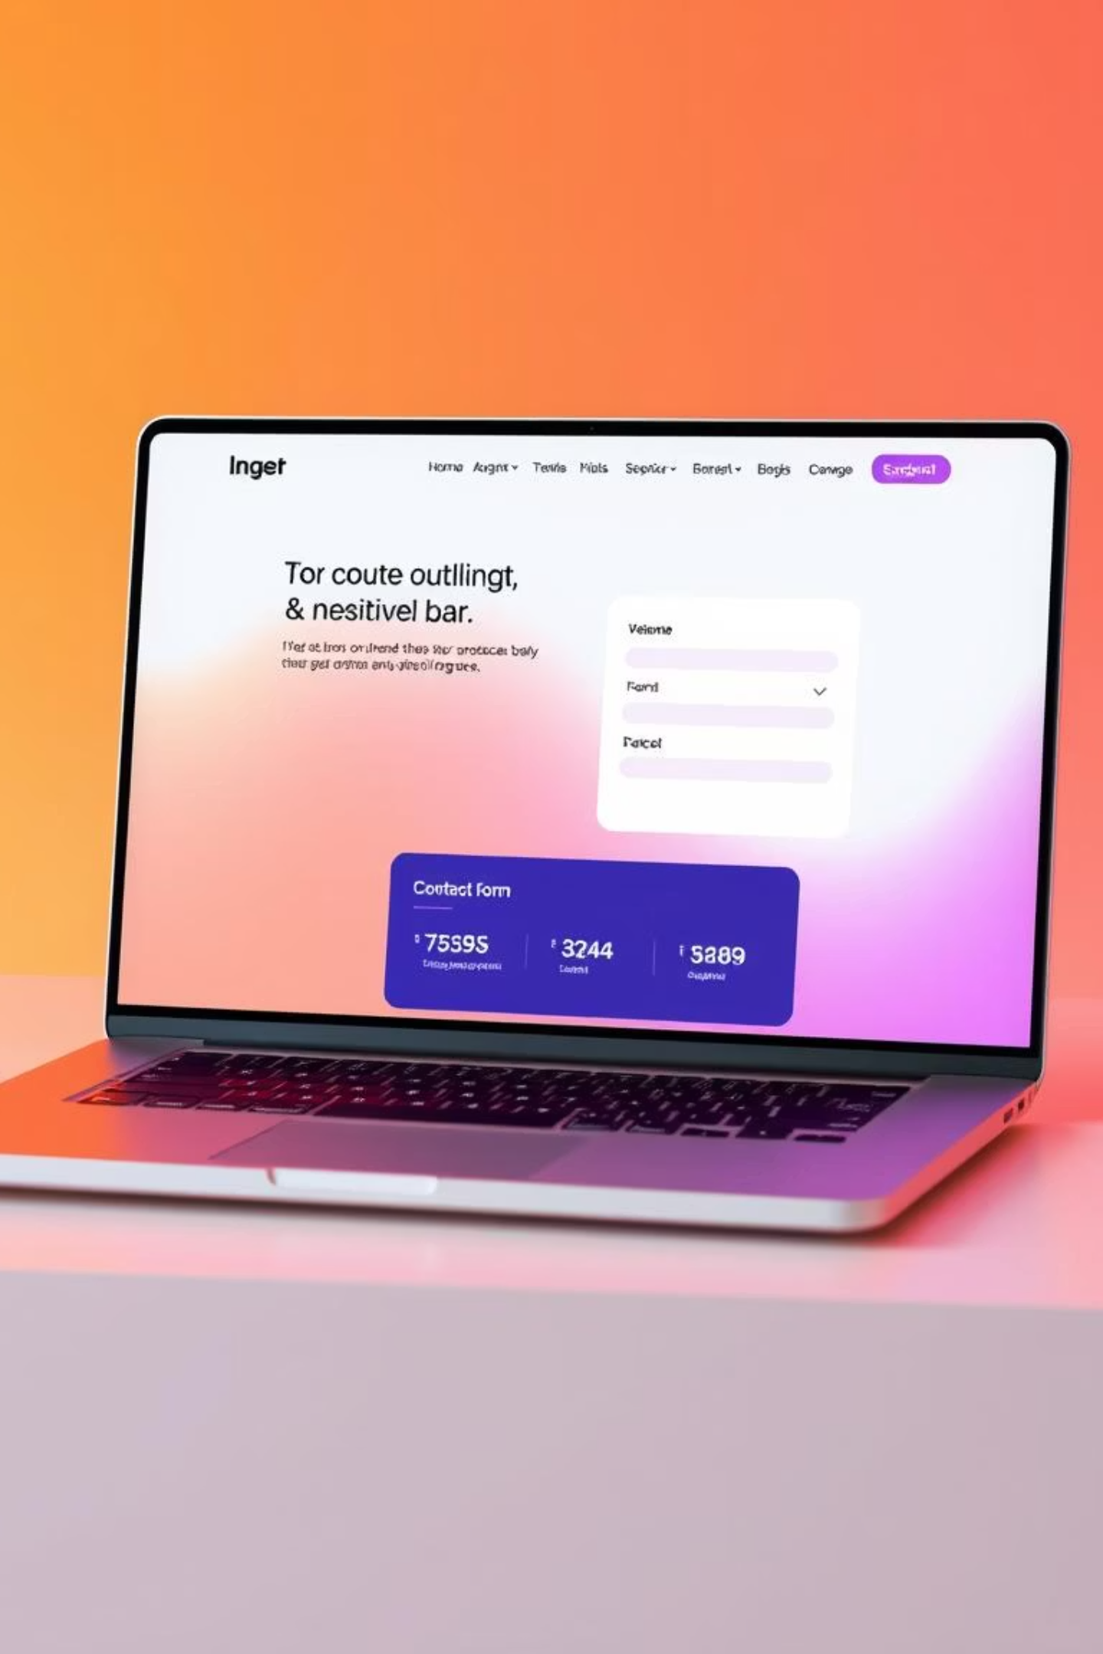
Core Features
Responsive navigation bar across all pages.
Clean and modern layout powered by Bootstrap.
Consistent branding using custom stylesheet.
Contact form to collect user queries.
Scroll-friendly layout optimized for various screen sizes.

Slide 6




Suggestions for Further Development
Backend Integration
Dynamic Content
Add Node.js or Java Spring Boot for form submissions.
Implement using JavaScript or React.
SEO & Engagement
Enhance Accessibility
Include testimonials, blog/news pages.
Add ARIA labels and tab navigation.

Slide 7

Future Enhancements
Location Services
Use Google Maps or an API to embed location services for pet care facilities.
Full-Stack Potential
Foundation for a Java-based web app with Spring Boot and MySQL.

Slide 8

Summary: A Strong Foundation
This project demonstrates a strong grasp of responsive web design using Bootstrap and semantic HTML, providing a great foundation for a full-stack Java-based web application.

